Slide 1
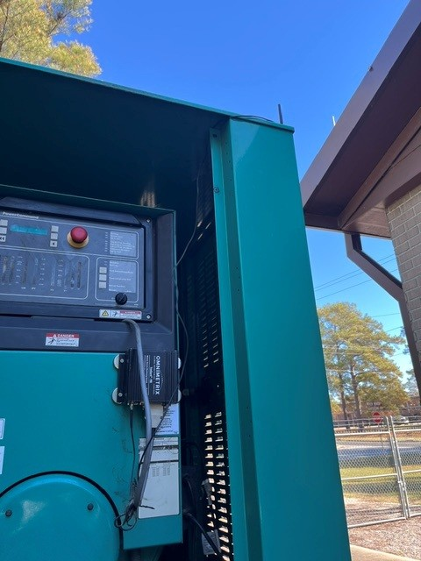
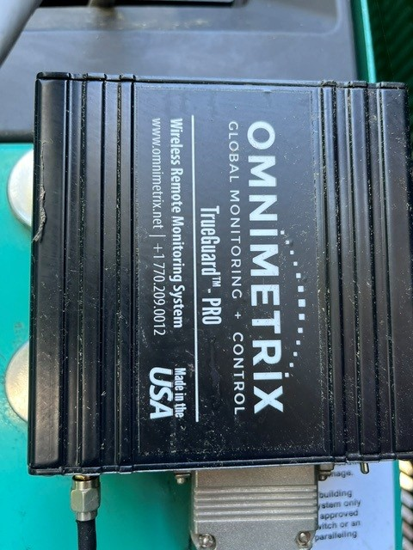
Typical Generator at Fort Jackson
Antenna
(magnetic attachment)
Monitor
(magnetic attachment)

Slide 2
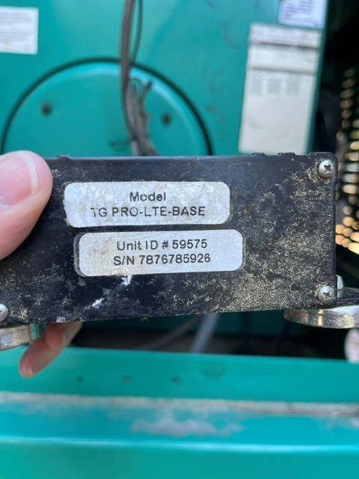
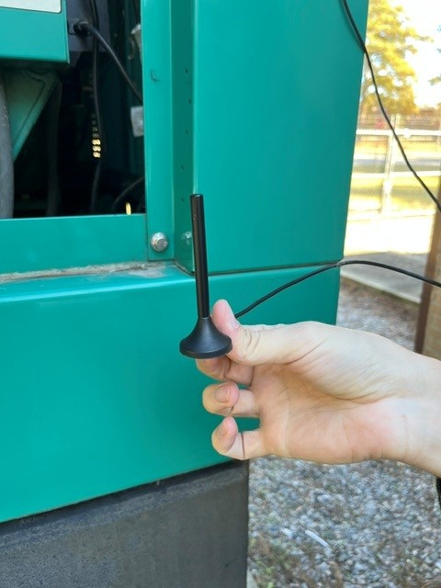
Typical Generator at Fort Jackson
Antenna
Monitor

